Slide 1
Overview
Memory Hierarchy
Main Memory
Auxiliary Memory
Associative Memory
Cache Memory
Virtual Memory
Memory Management Hardware

Slide 2
Memory Hierarchy
  Memory unit essential component since used for storing programs and data
  Computers would run efficiently if equipped with additional storage beyond main memory
  Its more economical to use low cost storage device to serve as back up for storing information that is not currently used by CPU
  The memory unit that communicates directly with CPU is called Main Memory
      RAM
  Device that provides backup storage is called Auxiliary memory
      Magnetic Disk and Tapes
  Program and data needed by CPU resides in Main memory. All other information stored in auxiliary memory and transferred to main memory when needed

Slide 3
Memory Hierarchy
    Cache Memory : special very-high-speed memory to increase the processing speed by making current program and data available to CPU at rapid rate (Cache RAM)
    Cache compensate difference between Main memory access time and processor logic
    Auxiliary Vs. Cache memory
    > Holds data not used presently, hold data heavily used by CPU.
    > CPU direct access to cache and M/M but not Auxiliary Memory.
    > Access time ratio between Cache and M/M is about 1to 7
    > Access time : Cache:100ns,
    M/M: 700ns
    Auxiliary memory: 1000 times that of M/M.
  Memory Heirarchy

Slide 4
Memory Hierarchy
Memory Hierarchy is to obtain the highest possible access speed while minimizing the total cost of the memory system
Magnetic
tapes
I/O
Main
processor
memory
Magnetic
disks
CPU
Cache
memory
Register
Cache
Main Memory
Magnetic Disk
Magnetic Tape

Slide 5
Main Memory
  Relatively large and fast memory used to store program and data during computer operation
  RAM of two types :
    Static RAM : consists of internal flip flop for storing binary information
    - shorter Read and write cycle
    - used for implementing cache memory
    Dynamic RAM : Stores binary information in the form of electric charges that are applied to capacitors
    - capacitor tend to discharge with time periodically refreshed
    - reduced power consumption and larger storage capacity in
    single memory chip
    - used for implementing Main Memory

Slide 6
Main Memory
    Read-Only-Memory (ROM) :
    - used for storing program that are permanently resident of
    computer and do not change in value once the production of
    computer is complete .
    Bootstrap Loader : A program whose function is to start the computer software operating when power is turned on.
        When power turned on, h/w sets PC to first address of bootstrap loader.
        The bootstrap loads the portion of (Operating System) OS from disk to Main Memory
        and control is transferred to OS which prepare computer for general use

Slide 7
Main Memory
RAM and ROM Chips available in variety of sizes. If required larger capacity than one chip it is necessary to
Combine no . of chips to form reqd. memory size . Here it is shown to construct 1024x 8 Memory using
128x8 RAM and 512x8 ROM
Typical RAM chip
Chip select 1
CS1
Chip select 2
CS2
128 x 8
Read
RD
RAM
8-bit data bus
Write
WR
7-bit address
AD 7
CS1 CS2 RD WR
Memory function
State of data bus
0 0 x x
Inhibit
High-impedence
Work only when
CS1=1 and CS2 = 0
0 1 x x
Inhibit
High-impedence
1 0 0 0
Inhibit
High-impedence
1 0 0 1
Write
Input data to RAM
1 0 1 x
Read
Output data from RAM
1 1 x x
Inhibit
High-impedence
Typical ROM chip
Chip select 1
CS1
Data bus in O/P mode since ROM can only read
Chip select 2
CS2
512 x 8
8-bit data bus
ROM
9-bit address
AD 9

Slide 8
  Memory Address Map : pictorial assignment of assigned address space for
  each chip in system
    Memory Configuration : 512 bytes RAM + 512 bytes ROM
      1 x 512 byte ROM + 4 x 128 bytes RAM
    Memory Address Map : Tab. 12-1
      Address line 9 8
        RAM 1 0 0 : 0000 - 007F
        RAM 1 0 1 : 0080 - 00FF
        RAM 1 1 0 : 0100 - 017F
        RAM 1 1 1 : 0180 - 01FF
      Address line 10
        ROM 1 : 0200 - 03FF
    Memory Connection to CPU : Fig. 12-4
      2 x 4 Decoder : RAM select (CS1)
      Address line 10
        RAM select : CS2
        ROM select : of CS2 Invert
      Reference
        RD: ROM CS1 of normal
        OE (Output Enable) as

Slide 9
Memory Address Map
Address space assignment to each memory chip
Example: 512 bytes RAM and 512 bytes ROM
Hexa
address
Address bus
Component
10 9 8 7 6 5 4 3 2 1
RAM 1
RAM 2
RAM 3
RAM 4
ROM
0000 - 007F
0080 - 00FF
0100 - 017F
0180 - 01FF
0200 - 03FF
0 0 0 x x x x x x x
0 0 1 x x x x x x x
0 1 0 x x x x x x x
0 1 1 x x x x x x x
1 x x x x x x x x x
Memory Connection to CPU
RAM and ROM chips are connected to a CPU through the data and address buses
- The low-order lines in the address bus select the byte within the chips and other lines in the address bus select a particular chip through its chip select inputs

Slide 10

Connection of Memory to CPU
Address bus
CPU
16-11
10
9
8
7-1
RD
WR
Data bus
Decoder
3
2
1
0
CS1
CS2
128 x 8
Data
RD
RAM 1
WR
AD7
CS1
CS2
128 x 8
Data
RD
RAM 2
WR
AD7
CS1
Example showing the construction of 1024x8 Memory using 128x8 RAM Chip and 512x8 ROM Chip
CS2
128 x 8
Data
RD
RAM 3
WR
AD7
CS1
CS2
128 x 8
RD
RAM 4
Data
WR
AD7
CS1
1- 7
CS2
512 x 8
8
ROM
Data
9
AD9

Slide 11
Overview
Memory Hierarchy
Main Memory
Auxiliary Memory
Associative Memory
Cache Memory
Virtual Memory
Memory Management Hardware

Slide 12
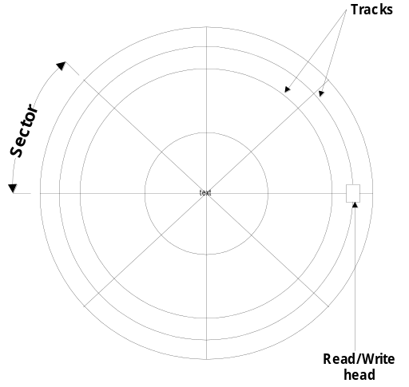

12-3 Auxiliary Memory
Common auxiliary memory devices used in computer are :
  Magnetic Disk : FDD, HDD
  Magnetic Tape : Backup or Program
Other Components used but not frequently are :
  Optical Disk : CDR, ODD, DVD
  Magnetic Drums etc
The important characteristic of any device is :
  Access mode, Access time, seek time, transfer rate, cost , capacity
  Access Time = Seek time + Transfer time

Slide 13
Magnetic Disks
- Circular plate constructed of metal or plastic coated with magnetized material
- Often both sides of disks are used and stacked on one spindle with read/write
head available on each surface
Disks are divided into concentric circles called track and each track into sectors
Read/write head positioned into each track and waits until rotating disk reaches
the specified sector under read/write head
Disk may have several head and simultaneous transfer from several track at a time
In order to maintain all tracks of equal data some disks use variable recording density with higher density of tracks near center than far away.
Magnetic Tape
A tape itself is a strip of plastic coated with magnetic recording medium
Bits are recorded as magnetic spots on the tape along several track
Cannot start stop RW head between characters so recorded in blocks called records

Slide 14
Associative Memory
- Accessed by the content of the data rather than by an address
Also called Content Addressable Memory (CAM)
Accessed simultaneously in parallel on the basis of data .
Expensive than random access memory
Argument register(A)
Hardware Organization
Key register (K)
Match
register
Input
Associative memory
array and logic
M
Read
m words
Write
n bits per word
- Compare each word in CAM in parallel with the content of A(Argument Register)
- If CAM Word[i] = A, M(i) = 1
- Read sequentially accessing CAM for CAM Word(i) for M(i) = 1
- K(Key Register) provides a mask for choosing a particular field or key in the argument in A
(only those bits in the argument that have 1’s in their corresponding position of K arecompared)

Slide 15
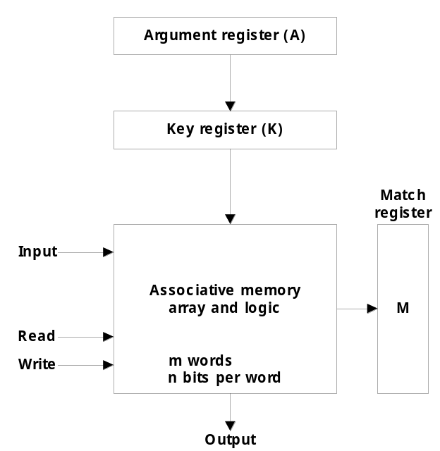
12-4 Associative Memory
  Content Addressable Memory (CAM)
    A memory unit accessed by content
    Block Diagram : Fig. 12-6
Name
Address
A Register 101 111100
K Register 111 000000
Word 1 100 111100 M = 0
Word 2 101 000011 M = 1
Argument
Key (Mask)
Memory contents
Match Logic
M = 1 when the output

Slide 16
Organization of CAM
A₁
A_{j}
A_{n}
K₁
K_{j}
K_{n}
Word 1
C₁₁
C_{1j}
C_{1n}
M₁
Word i
C_{i1}
C_{ij}
C_{in}
M_{i}
Word m
C_{m1}
C_{mj}
C_{mn}
M_{m}
Bit 1
Bit j
Bit n
Internal organization of a typical cell C_{ij}
Input
A_{j}
K_{j}
Write
R
S
F
Match
To
M
Read
ij
logic
i
Output

Slide 17
Match Logic
K
A
K
A
K
A
1
1
2
2
n
n
F'
F
F'
F
. . . .
F'
F
i1
i1
i2
i2
in
in
M
i

Slide 18
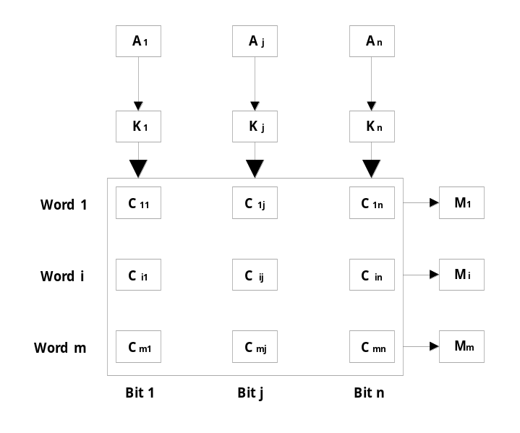
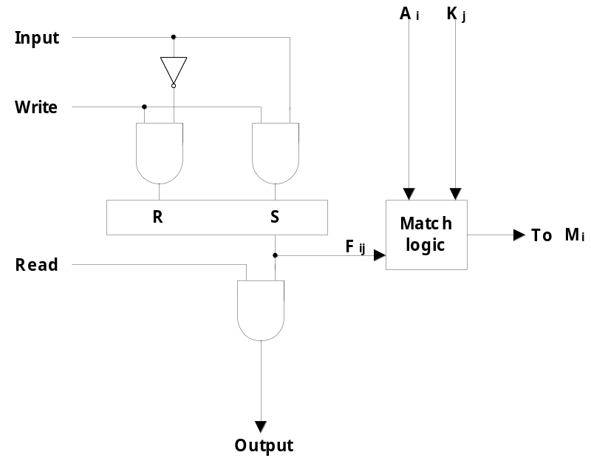
  m word x n cells per word : Fig. 12-7
  Match Logic
    One cell of associative memory : Fig. 12-8
      Write Input = 1 or 0, depending on the signal at the same time as F / F stored in
      Match Logic by A and K is in the M = 1 (M directly connected to the READ available)
      Read the signal according to the F / F reads data from

Slide 19
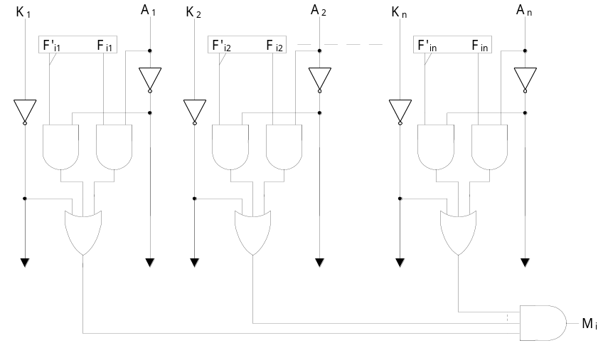

    Match Logic : Fig. 12-9
      Aj = Argument, Fij = Cell ij the second bit
      j-th bit match conditions
      xj = Aj Fij + Aj 'Fij'
      1 - n to n bits match the condition Mi = x1x2 ..... xn
      Key bit K_{j} : x_{j} + K_{j}’
        K_{j} = 0 : no comparison ( K_{j} : x_{j} + 1 = 1 )
        K_{j} = 1 : comparison ( K_{j} : x_{j} + 0 = x_{j} )
      Match Logic for word I :
      M_{i} = (x₁ + K₁’) (x₂ + K₂’)…. (x_{n} + K_{n}’)
      = ( x_{j} + K_{j}’)
      = ( A_{j} F_{ij} + A_{j}’ F_{ij}’ + K_{j}’ )

Slide 20
Memory Organization <number> Lecture 42
Overview
Memory Hierarchy
Main Memory
Auxiliary Memory
Associative Memory
Cache Memory
Virtual Memory
Memory Mgt Hardware

Slide 21
Memory Organization <number>
Cache Memory
Locality of Reference
- The references to memory at any given time interval tend to be confined within a localized areas
-It states that over a short interval of time, the address generated by a typical
program refer to a few localized area of memory repeatedly, while the
remainder of memory is accessed relatively infrequently
- Temporal Locality
The information which will be used in near future is likely to be in use already( e.g. Reuse of information in loops)
- Spatial Locality
If a word is accessed, adjacent(near) words are likely accessed soon
(e.g. Related data items (arrays) are usually stored together;
instructions are executed sequentially)
- Loops and subroutines tends to localize the reference to memory for fetching
instructions
- If active portion of program and data placed in fast small memory , avg access time
can be reduced. Cache memory is faster than main memory with a factor of 5 to 10

Slide 22
Memory Organization <number>
Cache Memory
Such a fast memory is called cache
It is placed between main memory and CPU as shown below
Cache
- The property of Locality of Reference makes the cache memory systems work
- Cache is a fast small capacity memory that should hold those information
which are most likely to be accessed
- Basic operation of cache
Main memory
32K x 12
CPU
Cache memory
512 x 12

Slide 23
Memory Organization <number>
Performance of Cache
Memory Access
All the memory accesses are directed first to Cache
If the word is in Cache; Access cache to provide it to CPU
If the word is not in Cache; Bring a block (or a line) including
that word to replace a block now in Cache
- How can we know if the word that is required is there ?
- If a new block is to replace one of the old blocks, which one should we choose ?
Performance of Cache Memory System
Hit Ratio - % of memory accesses satisfied by Cache memory system
Te: Effective memory access time in Cache memory system
Tc: Cache access time
Tm: Main memory access time
Te = Tc + (1 - h) Tm
Example: Tc = 0.4 μs, Tm = 1.2μs, h = 0.85%
Te = 0.4 + (1 - 0.85) * 1.2 = 0.58μs

Slide 24
Memory Organization <number>
Memory and Cache Mapping – (Associative Mapping)
Mapping Function
Specification of correspondence between main memory blocks and cache blocks
Associative mapping
Direct mapping
Set-associative mapping
Associative Mapping
- Any block location in Cache can store any block in memory
-> Most flexible
- Mapping Table is implemented in an associative memory
-> Fast, very Expensive
- Mapping Table
Stores both address and the content of the memory word
address (15 bits)
Argument register
Address
Data
CAM
0 1 0 0 0
3 4 5 0
0 2 7 7 7
6 7 1 0
2 2 2 3 5
1 2 3 4
Disadvantage: Expensive

Slide 25
Memory Organization <number>
Cache Mapping – direct mapping
- Each memory block has only one place to load in Cache
- Mapping Table is made of RAM instead of CAM
- n-bit memory address consists of 2 parts; k bits of Index field and n-k bits of Tag field
- n-bit addresses are used to access main memory and k-bit Index is used to access the Cache
Addressing Relationships
Tag(6) Index(9)
00 000
32K x 12
000
Main memory
512 x 12
Cache memory
Address = 15 bits
Address = 9 bits
Data = 12 bits
Data = 12 bits
77 777
777
Direct Mapping Cache Organization
Memory
Memory data
address
Cache memory
00000
1 2 2 0
Index
address
Tag
Data
00777
2 3 4 0
000
0 0
1 2 2 0
01000
3 4 5 0
01777
4 5 6 0
02000
5 6 7 0
02777
6 7 1 0
777
0 2
6 7 1 0

Slide 26
Memory Organization <number>
Cache Mapping – direct mapping
Operation
- CPU generates a memory request with (TAG;INDEX)
- Access Cache using INDEX ; (tag; data)
Compare TAG and tag
- If matches -> Hit
Provide Cache[INDEX](data) to CPU
- If not match -> Miss
M[tag;INDEX] <- Cache[INDEX](data)
Cache[INDEX] <- (TAG;M[TAG; INDEX])
CPU <- Cache[INDEX](data)
Direct Mapping with block size of 8 words
Block 0
000
0 1
3 4 5 0
Tag Block Word
007
0 1
6 5 7 8
010
INDEX
Block 1
017
Block 63
770
0 2
777
0 2
6 7 1 0

Slide 27
Memory Organization <number>
Cache Mapping – Set Associative Mapping
- Each memory block has a set of locations in the Cache to load
Set Associative Mapping Cache with set size of two
Index
Tag
Data
Tag
Data
000
0 1
3 4 5 0
0 2
5 6 7 0
777
0 2
6 7 1 0
0 0
2 3 4 0
Operation
- CPU generates a memory address(TAG; INDEX)
- Access Cache with INDEX, (Cache word = (tag 0, data 0); (tag 1, data 1))
- Compare TAG and tag 0 and then tag 1
- If tag i = TAG -> Hit, CPU <- data i
- If tag i ≠ TAG -> Miss,
Replace either (tag 0, data 0) or (tag 1, data 1),
Assume (tag 0, data 0) is selected for replacement,
(Why (tag 0, data 0) instead of (tag 1, data 1) ?)
Various replacement Algorithm followed : Random Replacement, FIFO, LRU

Slide 28
Memory Organization <number>
Cache Write
Two methods for updating main memory through cache
(1) Write Through
Update main memory with every memory write operation, with cache
memory being updated in parallel if it contains the word at the specified
address
Advantage:
-> Data in memory is always updated
-> Important when CPU and DMA I/O are both executing
Disadvantage:
-> Slow, due to the memory access time
(2) Write-Back (Copy-Back)
-> Only the cache location is updated during a write operation.
-> The location is then marked by flag so that later when the word is removed
from the cache it is copied into main memory.
Memory is not up-to-date, i.e., the same item in
Cache and memory may have different value
Cache Initialization : Initially when power is turned on. All the valid bits of cache marked as 0 showing as invalid bit . When a word is read from Main memory to cache its valid bits is made 1.

Slide 29
Overview
Memory Hierarchy
Main Memory
Auxiliary Memory
Associative Memory
Cache Memory
Virtual Memory
Memory Mgt Hardware

Slide 30
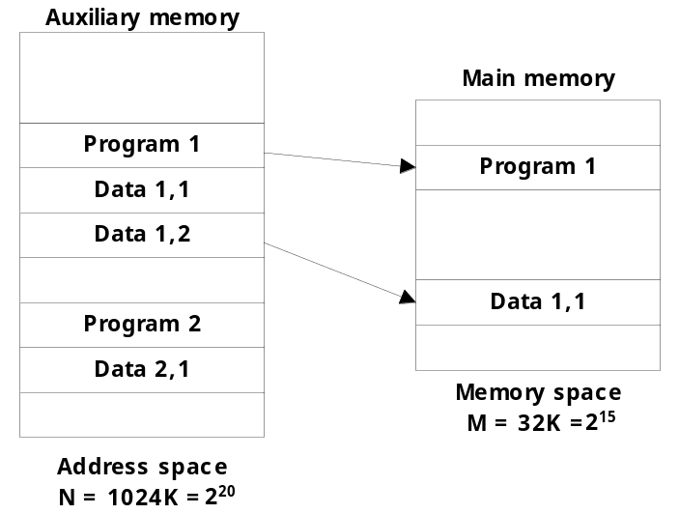
12-6 Virtual Memory
  Virtual Memory : Auxiliary memory Main memory
    Translate program-generated (Aux. Memory) address into main memory location
      Give programmers the illusion that they have a very large memory, even though the computer actually has a relatively small main memory
      Virtual memory system provides a mechanism for translating program generated addresses into correct main memory locations, while programs are being executed in CPU
  Address Space & Memory Space
    Address Space : Virtual Address
      Virtual Address : Address used by a programmer
      Address space : Set of virtual address
    Memory Space : Physical Address(Location)
      Physical address : Address in main memory
      Memory space : Set of physical address
  Examples : Fig. 12-16
    address space (N) = 1024 K = 2²⁰
      Auxiliary Memory
    memory space (M) = 32 K = 2¹⁵
      main Memory

Slide 31
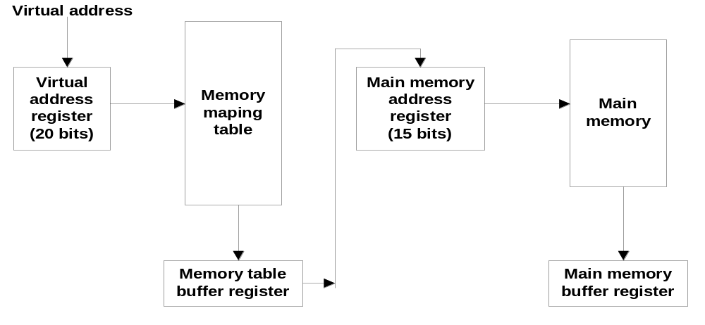
  Memory table for mapping a virtual address : Fig. 12-17
    Translate the 20 bits Virtual address into the 15 bits Physical address
      Mapping is a dynamic operation, translated when referenced by CPU
    Mapping table may be stored in :
      Separate memory : addition memory unit + 1 extra memory access time required
      Main memory : takes space from main memory + two access to memory required
      Third alternative is to use associative memory

Slide 32
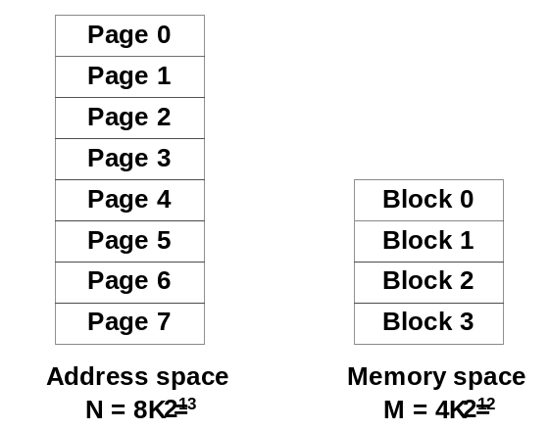
  Address Mapping Using Pages : Fig. 12-18
    Address mapping is simplified if address space and memory space divided into groups of equal size.
    Address space divided into → Pages
    Memory space divided into → Blocks (sometimes called Page Frame)
      Address space and memory space with a fixed size
      Enabled by splitting
      Address space: 1 K page divided into 8 pages
      Memory space: 1 k block divided into 4 blocks
      Address space in the memory space of the four page
      you can go on the block.

Slide 33
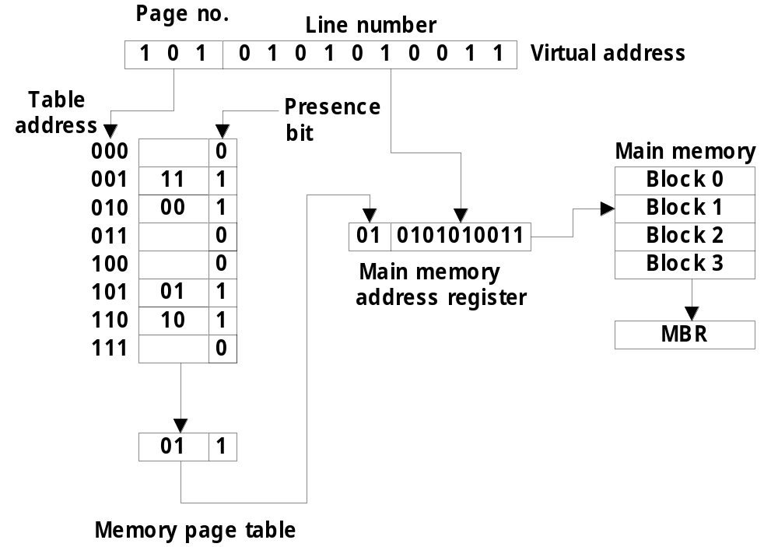
  Memory table in a paged system : Fig. 12-19

Slide 34
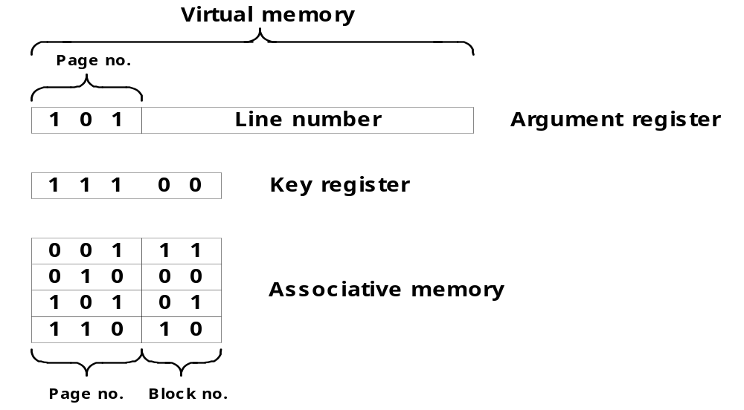
  Associative memory page table : Fig. 12-20
    Associative memory : Here no. of words equal to no. of blocks in main memory
  Page(Block) Replacement
    Page Fault : the page referenced by the CPU is not in main memory
      a new page should be transferred from auxiliary memory to main memory
    Replacement algorithm : FIFO LRU

Slide 35
Page Replacement
Decision on which page to displace to make room for an incoming page when no free frame is available
Modified page fault service routine
  Find the location of the desired page on the backing store
  Find a free frame
  - If there is a free frame, use it
  - Otherwise, use a page-replacement algorithm to select a victim frame
  - Write the victim page to the backing store
  3. Read the desired page into the (newly) free frame
  4. Restart the user process
valid/
frame
invalid bit
swap
out
1
victim
2
page
f
0
v
i
change to
victim
invalid
3
v
4
swap
f
reset page
desired
table for
page in
new page
backing store
page table
physical memory

Slide 36
Page Replacement Algorithms
FIFO
Reference string
7
0
1
2
0
3
0
4
2
3
0
3
2
1
2
0
1
7
0
1
7
7
7
2
2
2
4
4
4
0
0
0
7
7
7
0
0
0
3
3
3
2
2
2
1
1
1
0
0
1
1
1
0
0
0
3
3
3
2
2
2
1
Page frames
FIFO algorithm selects the page that has been in memory the longest time
Using a queue - every time a page is loaded, its identification is inserted in the queue
Advantage : Easy to implement
Disadvantage : May result in a frequent page fault
-
Optimal Replacement (OPT) - Lowest page fault rate of all algorithms
Replace that page which will not be used for the longest period of time
Reference string
7
0
1
2
0
3
0
4
2
3
0
3
2
1
2
0
1
7
0
1
7
7
7
2
2
2
2
2
7
0
0
0
0
4
0
0
0
1
1
3
3
3
1
1
Page frames

Slide 37
Page Replacement Algorithms
LRU
- OPT is difficult to implement since it requires future knowledge
- LRU uses the recent past as an approximation of near future.
Replace that page which has not been
used for the longest period of time
Reference string
7
0
1
2
0
3
0
4
2
3
0
3
2
1
2
0
1
7
0
1
7
7
7
2
2
4
4
4
0
1
1
1
0
0
0
0
0
0
3
3
3
0
0
1
1
3
3
2
2
2
2
2
7
Page frames
- LRU may require substantial hardware assistance
- Implemented by using counter which increments with time (aging register) whenever a page
is referenced the value of associated counter is set to 0.

Slide 38
Memory Management Hardware
Demand on computer memory brought by multiprogramming have created the need for a memory management system
A memory management system is a collection of hardware and software procedures for managing the various programs residing in memory
12-7 Memory Management Hardware
  Basic components of a Memory Management Unit
    1) Dynamic address relocation : Maps logical to physical memory addresses
    2) Sharing Common program by different user
    3) Program protection : protecting program from unauthorized access
  MMU : Must be supported by the OS
  1) CPU's built-in form
  2) form a separate memory controller

Slide 39
  Segment
    A set of logically related instruction or data elements associated with a given name
    a subroutine, an array of data, a table of symbol, user’s program
  Logical Address
    the address generated by a segmented program
    similar to virtual address
      Virtual Address : fixed-length page
      Logical Address : variable-length segment
  The user does not think of
  memory as a linear array
  of words. Rather the user
  prefers to view memory as
  a collection of variable
  sized segments, with no
  necessary ordering among
  segments.
Stack
Subroutine
Symbol
Table
SQRT
Main
Program
User's view of a program

Slide 40
  Segmented-page MMU
    Length of each segment allowed to grow or contract according to need of program
    Logical address partitioned into three fields
      Segment : specifies segment number
      Page : specifies the page within the segment
      Word : gives the specific word within the page
    If k bits in page, then a segment can be associated 1 to 2^{k} pages.
    two table (segment, page) ,
    memory reference from CPU requires 3 memory access
    To overcome, fast associative memory is used called TLB
      TLB (Translation Look-a-side Buffer)
        most recently reference table
        the first time a given block is referenced its value together with segment and page no. is entered
Logical address
Segment
Page
Word
Segment table
Page table
+
Block
Word
Physical address

Slide 41
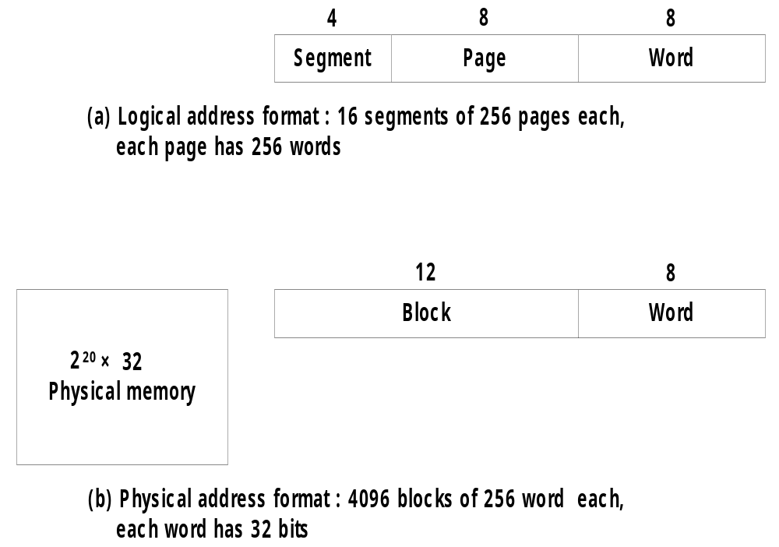
  Numerical Example
    Logical address & Physical address (Fig. 12-22)
      Logical Address :
        4 bit segment : 16 segments
        8 bit page : 256 pages
        8 bit word : 256 address field
      Physical Address :
        12 bit block : 4096 blocks
        8 bit word : 256 address field
Address
or Index

Slide 42
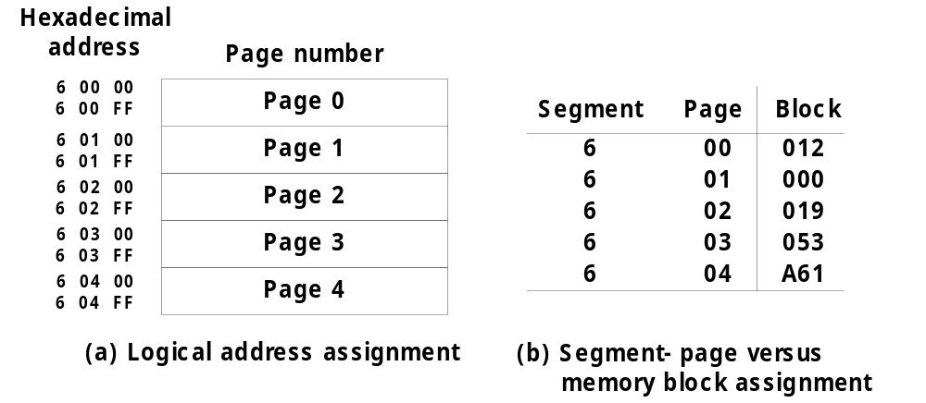
    Logical & Physical address assignment (Fig. 12-23)
Logical Address
Page Table
Segment
Page
Word
Find Block number 019

Slide 43



